Slide 1
PREDICTING SATISFACTION OF AIRLINE PASSENGERS

Slide 2

Presented By:
S.S.Nandhakumar MDS2032022
S.Navin MDS2032026
V.Vishnu Vikash MDS2032050

Slide 3
ABSTRACT
In the aviation industry, high-grade customer satisfaction is a key factor to run the business, as the airline industry is very competitive and customer loyalty varies with small changes in the services. Therefore, companies need to understand the customers’ need to deliver unparalleled experiences to retain customers. Using the customer’s satisfaction dataset, we here to analysis the reasons for customer experience being satisfied or not. Based on that, improvements will be made to provide better service by the airline company. Also, as part of the analysis, we will be able to understand several factors which improve customer satisfaction level.

Slide 4
OBJECTIVE
The main aim of this project is to determine the relative importance of each parameter with regards to their contribution to passenger satisfaction using both analytical techniques and predictive algorithm.
Specific objectives are:
To analysis the dataset and understand which variable plays an important role in passengers satisfaction.
And to predict their satisfaction on the basis of their feedback.
And to check the accuracy of the prediction.

Slide 5
DATASET
Our dataset of passengers feedback and rating was downloaded from Kaggle and imported into the program.
The dataset contains over 1,29,880 entries.
It contains passengers personal information such as ID, gender, purpose of travel and age.
It also contains their details of their flight class (Economy, Business, Eco-Plus), type of customer(first time or regular customer) and flight distance.
And it also contains passengers ratings and feedback on different categories and features of the flight(Wi-Fi, Leg room, Food, etc.).

Slide 6
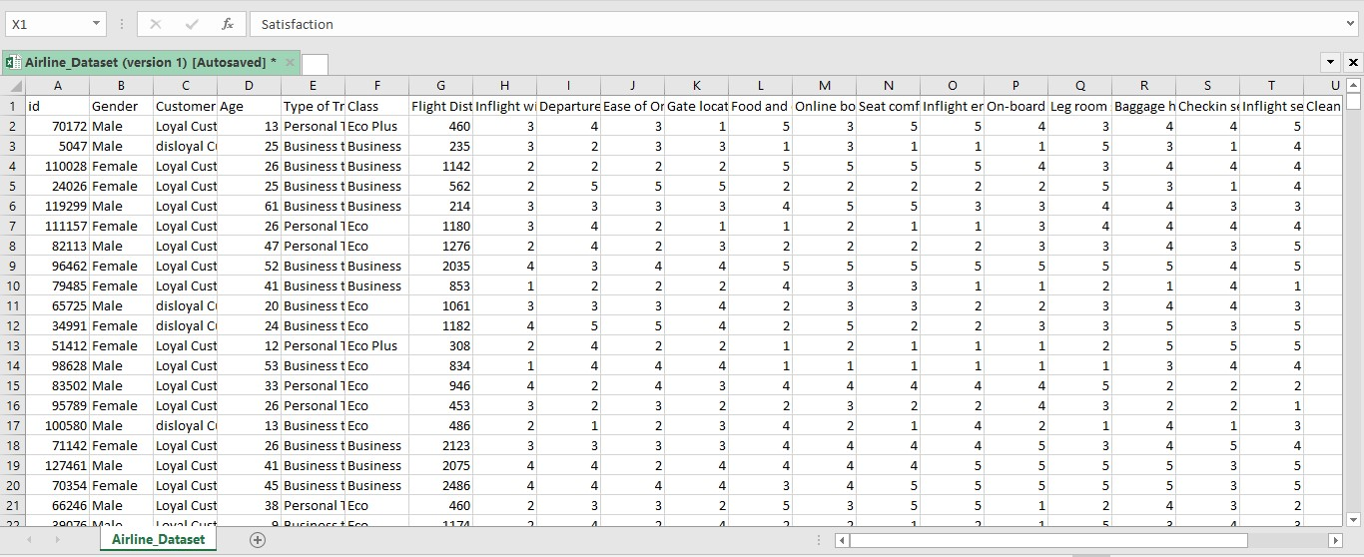
A sample part of our dataset(Airline_dataset).

Slide 7
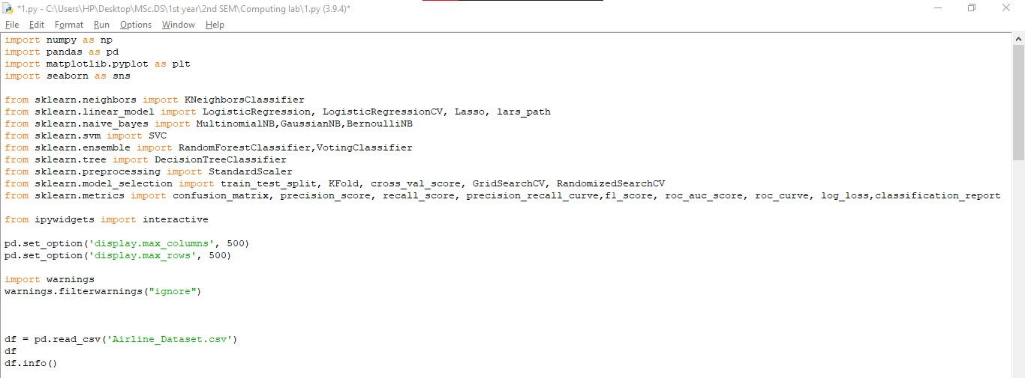
IMPORTING DATA
All the important python library and the DATASET are imported into python

Slide 8
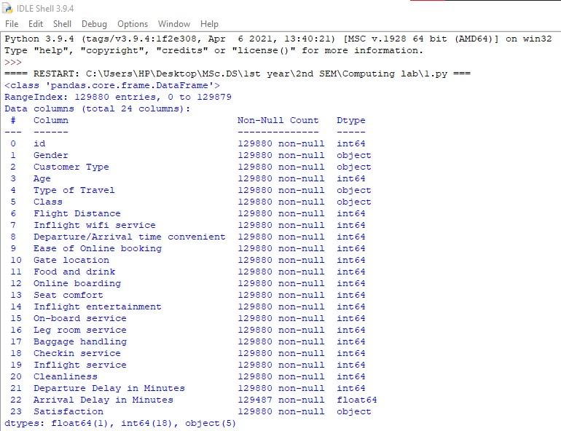
Here is the information of DATASET

Slide 9
EXPLORATORY DATA ANALYSIS AND FEATURE SELECTION
Create visualizations to first understand business problem, and also identify important features for model building:
Find out proportion of classes in target, and split them by Type of Travel and Type of Customers (To understand trend of satisfaction - useful later in model evaluation)
Identify feature significance for model through visualizing Graph plots, LASSO path and correlation heatmap.
After evaluation and discreet selection, We have decided to drop 'Gender, 'Total Delay','Flight Distance','Age','Gate Location' and 'Departure/Arrival Time Convenience'

Slide 10
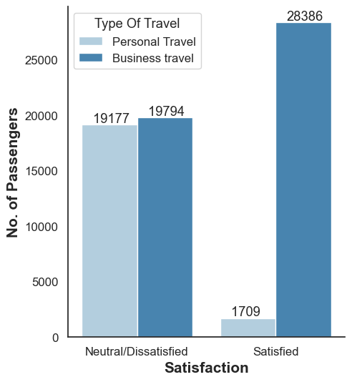
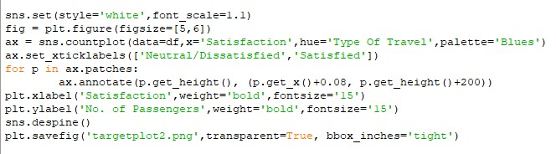
GRAPHS
Graphs play an important role in displaying and analysing quantitative data.
Here is a customized graph showing passenger satisfaction based on the purpose of travel:

Slide 11
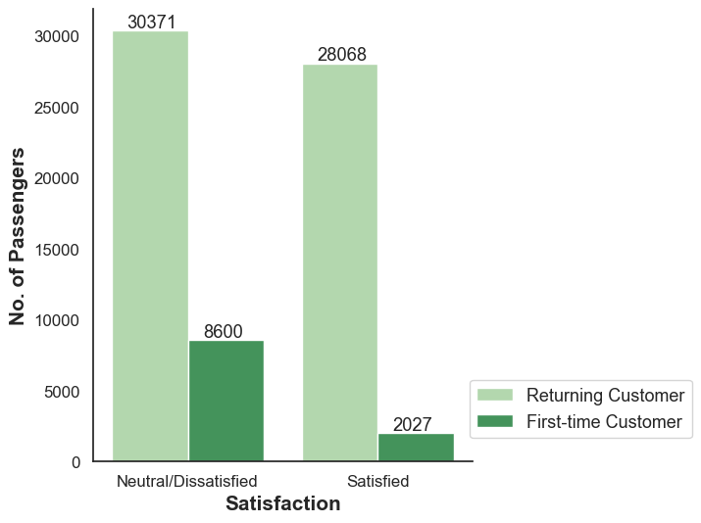
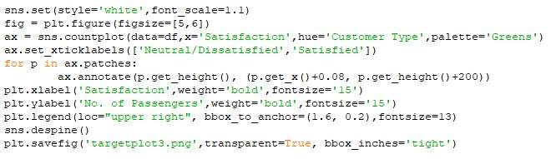
This graph shows passenger satisfaction based on type of customer(whether first time or regular customer):

Slide 12
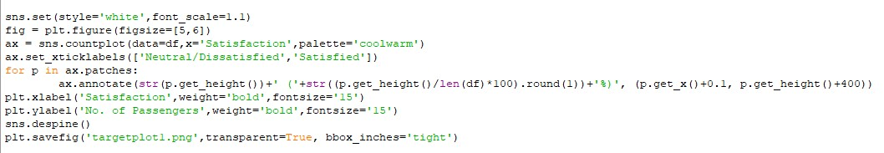
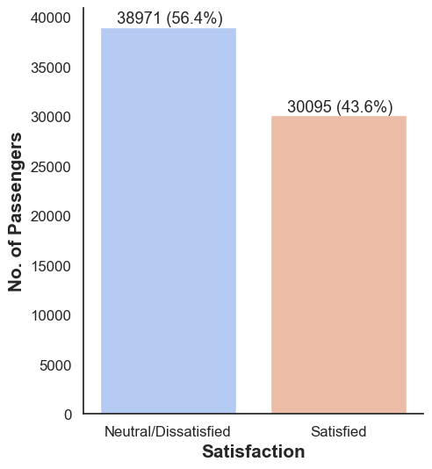
Here this graph shows overall passengers satisfaction irrespective of the categories and feature:

Slide 13
FEATURE SELECTION
KERNEL DENSITY ESTIMATION:
Now with the help of KDE, a technique that let's you create a smooth curve given a set of data. This can be useful if you want to visualize just the “shape” of some data, as a kind of continuous replacement for the discrete histogram.
This helps us in determining the important features(variables) that matters in passengers satisfaction. We can remove all the other features which does not play any roll in customers satisfaction prediction.
The next slide contains KDE plots:

Slide 14
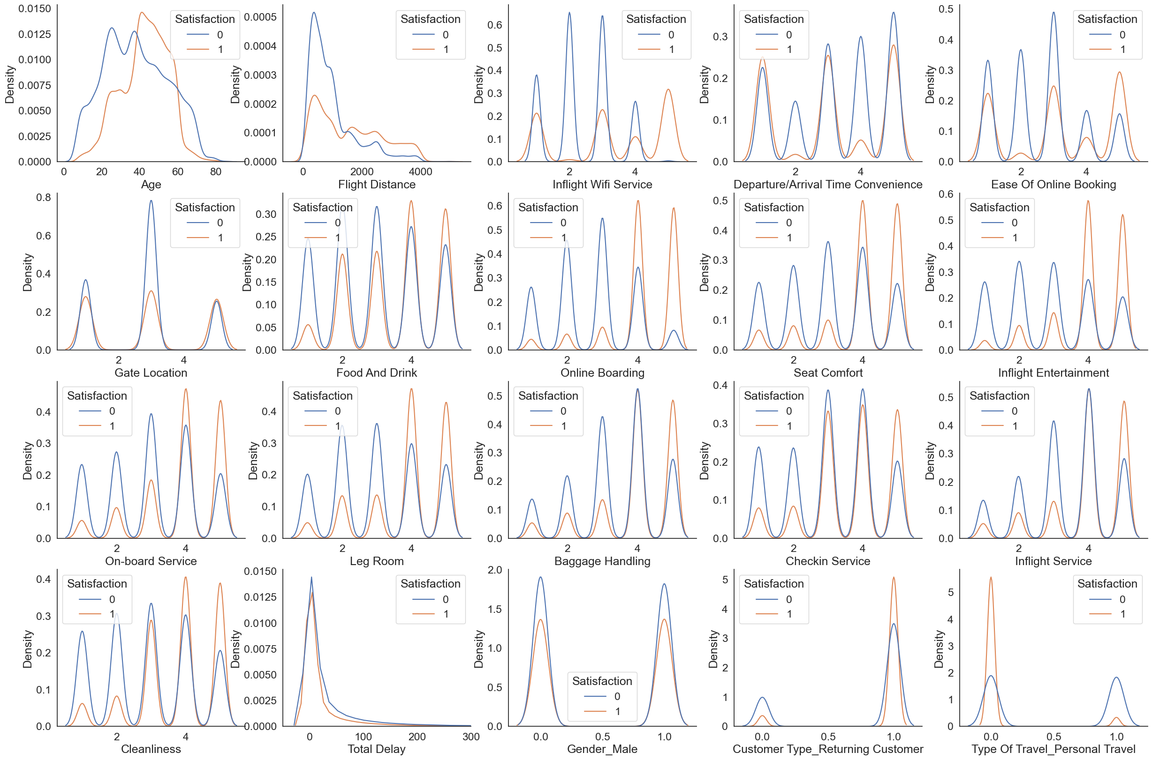

Slide 15
CORELLATION HEATMAP:
In statistics, correlation or dependence is any statistical relationship, whether causal or not, between two random variables or bivariate data. In the broadest sense correlation is any statistical association, though it commonly refers to the degree to which a pair of variables are linearly related.
Correlations are useful because they can indicate a predictive relationship that can be exploited in practice.
A correlation heatmap uses coloured cells, typically in a monochromatic scale, to show a 2D correlation matrix (table) between two discrete dimensions or event types. Correlation heatmaps are ideal for comparing the measurement for each pair of dimension values.

Slide 16
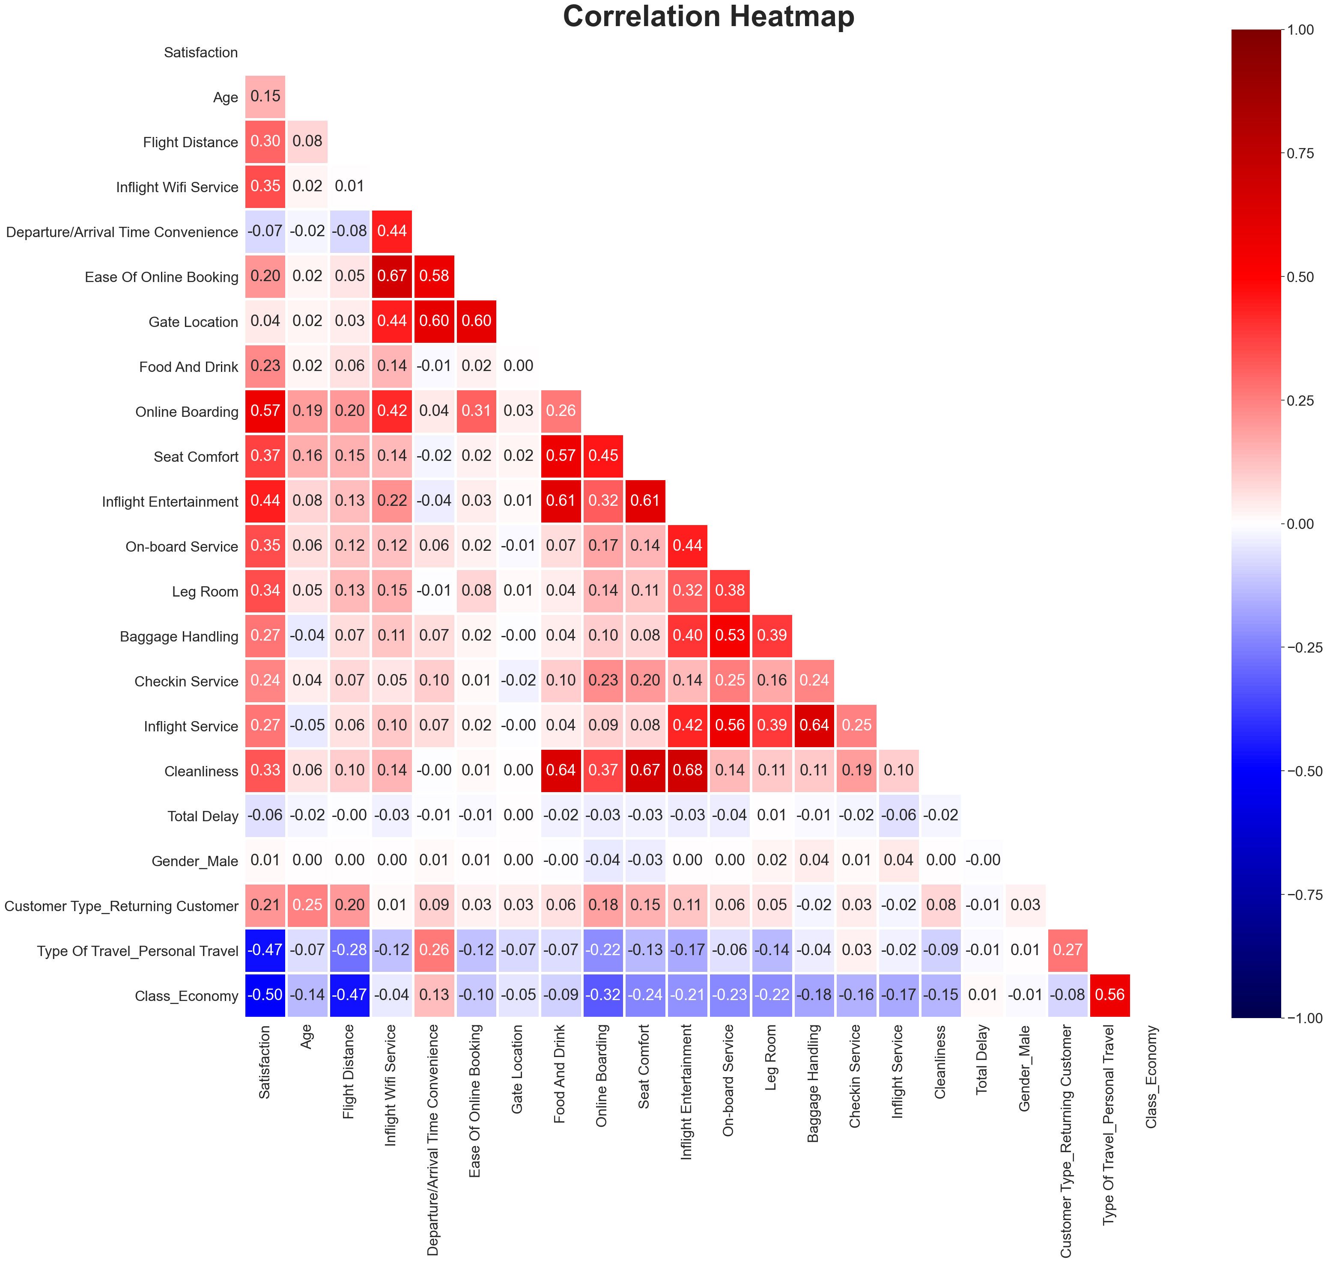

Slide 17
LASSO PATH:
In statistics and machine learning, lasso (least absolute shrinkage and selection operator; also Lasso or LASSO) is a regression analysis method that performs both variable selection and regularization in order to enhance the prediction accuracy and interpretability of the resulting statistical model.
Lasso was originally formulated for linear regression models. This simple case reveals a substantial amount about the estimator. These include its relationship to ridge regression and best subset selection and the connections between lasso coefficient estimates and so-called soft thresholding. It also reveals that (like standard linear regression) the coefficient estimates do not need to be unique if covariates are collinear.

Slide 18
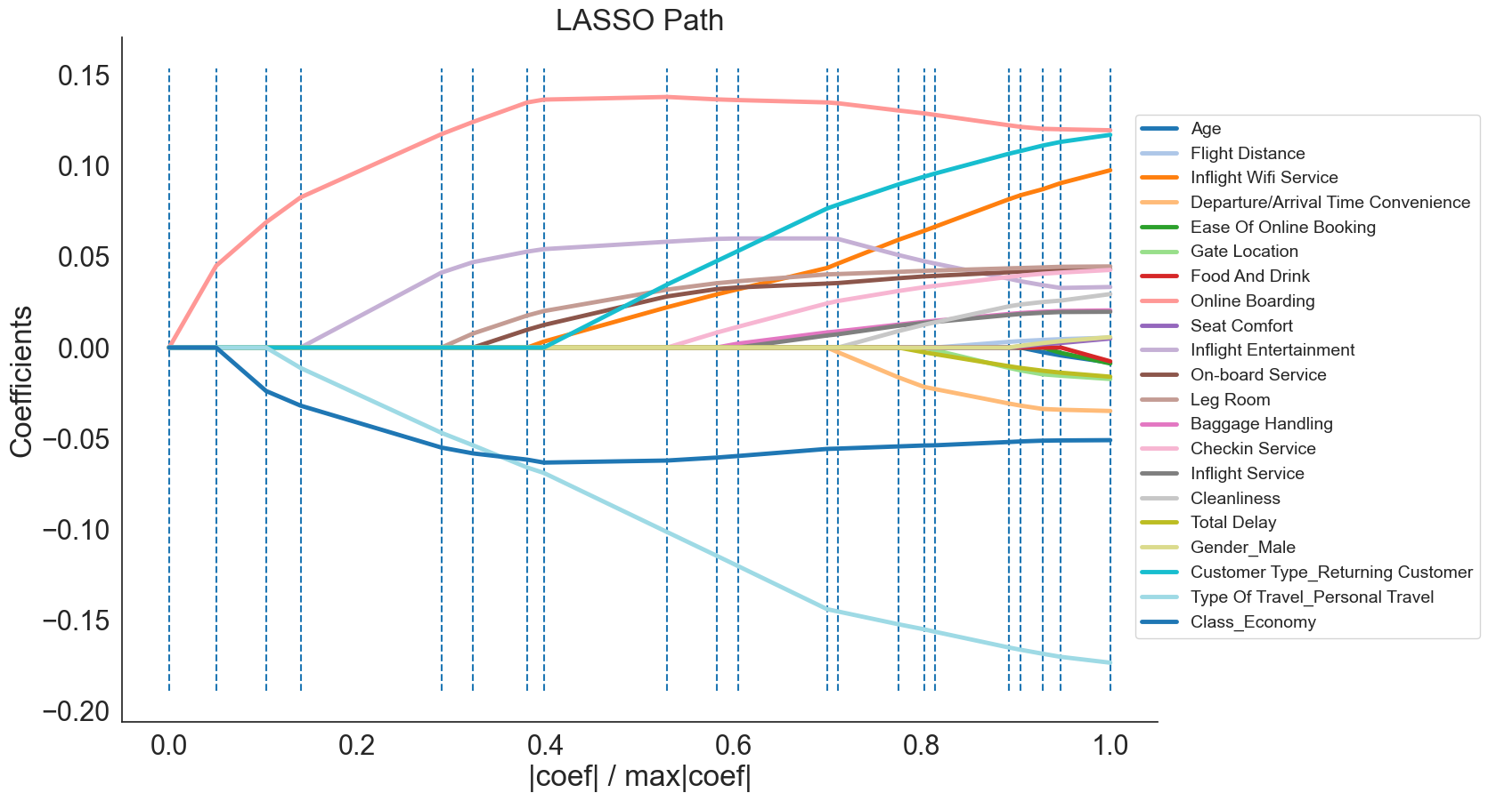

Slide 19
FEATURES TO DROP
After analysing the dataset thoroughly we understand which features play important role in passengers satisfaction and which does not.
Features to drop:
Gender
Age
Gate Location
Total Delay
Flight Distance
Departure/Arrival Time Convenience

Slide 20
AFTER ANALYSING THE DATASET THERE ARE FEW CONCLUSIONS:
Airlines should highly focus on inflight wi-fi experience.
Ease of online booking is important for business customers.
The airlines should provide better on-board service.
Need to concentrate more on economy class passengers.
The customers are satisfied with the food and services.
The customers like the seat comfort.

Slide 21
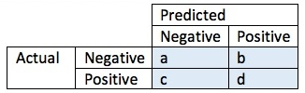
CONFUSION MATRIX
A confusion matrix, in predictive analytics, is a two-by-two table that tells us the rate of false positives, false negatives, true positives and true negatives for a test or predictor.
Suppose your confusion matrix is a simple 2 by 2 table, given by:
Here a is the number of true negatives, and d the number of true positives. b is the number of false positives, and c is the number of false negatives.
The accuracy of the prediction or test is defined as (a + d)/(a + c + d + e).

Slide 22
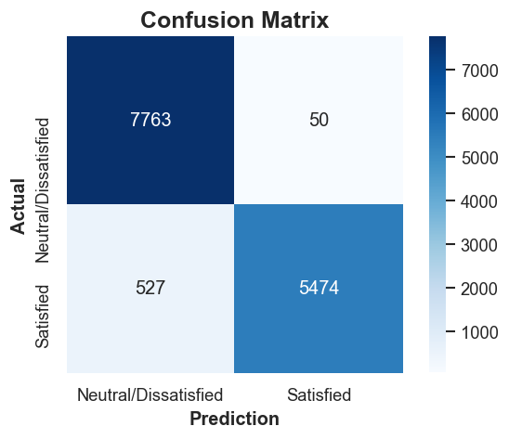
Therefore according to our confusion matrix:
The accuracy of the prediction or test is defined as (a + d)/(a + c + d + e).
PRECISION = 99.1%

Slide 23
FUTURE DEVELOPEMENTS
Can add more features for checking passengers satisfaction
Collect more data and check satisfaction
Improve the precision value
Drop all unwanted features
Personal review and feedback can also be added.
Flight booking services can also be added

Slide 24
THANK YOU!!!

